Slide 1
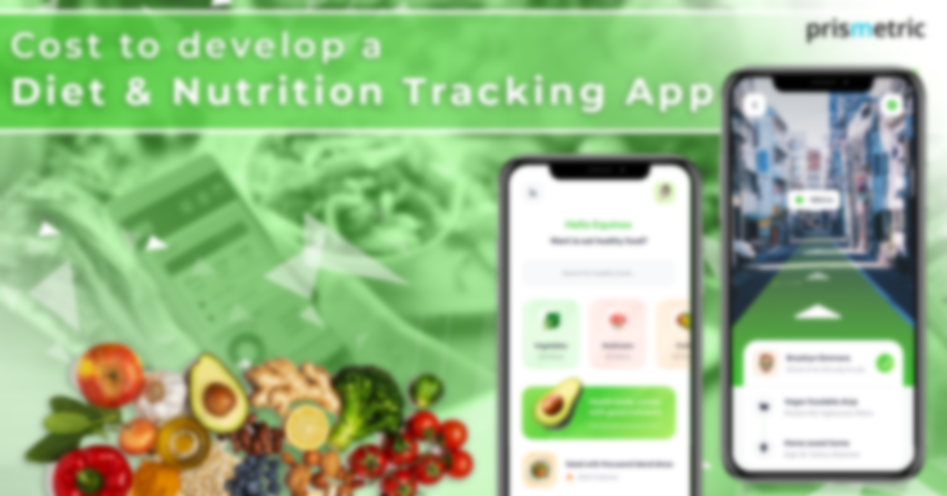
NutriClick
CUSTOMIZE YOUR NUTRITION IN ONE CLICK!
UI Design

Slide 2
“Let food be thy medicine and medicine be thy food.”
—Hippocrates

Slide 3
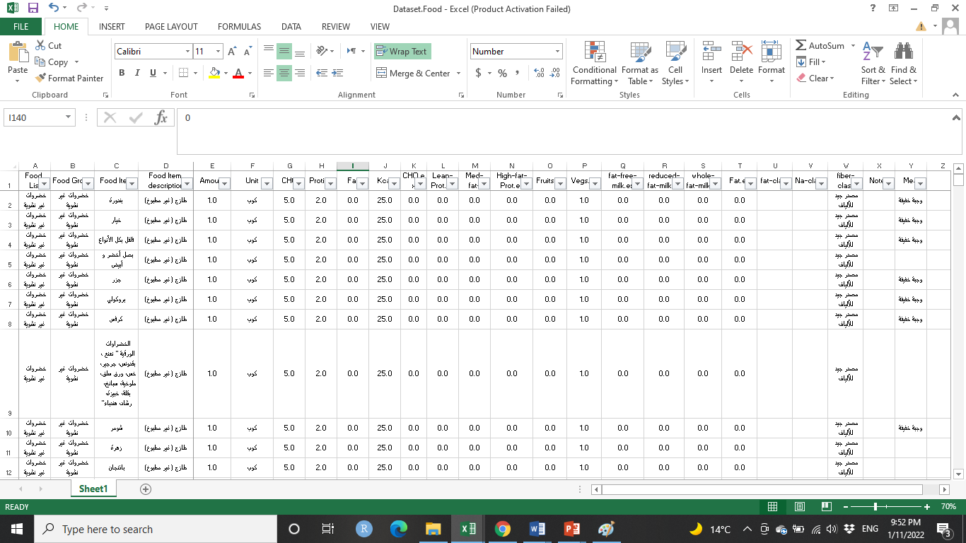
NutriClick
Smart personalized nutrition system, providing timely nutritional advice to guide diet patterns
“Goal”
To Provide users with a personalized system tailored to the Middle East region that provides comprehensive nutritional information and builds diet and exercise routines to improve health and quality of life
“Data Source”
Food Composition database compiled from different scientific research

Slide 4
NutriClick
UI Design
First Draft
Add a link for the app or any reference IDK?

Slide 5
Stay Healthy with NutriClick!
THANK YOU!

